Slide 1
Predicting crime In Montgomery county, MD

Slide 2
The Data
Dataset | Comments
Crimes Dataset | 240,000 crimes that took place in Montgomery County from 2015 to the present. Primary Variables: type of crime, the number of victims, the type of locations where crimes occurred (e.g. residential street, grocery store, commercial parking lot, etc.), and the police districts where crimes occurred.
Montgomery County Census Block Dataset (Based on the 2019 ACS) | Primary Variables: median income, population, median age, number of unemployed individuals, number of individuals by highest educational attainment, number of individuals by race, and number of individuals who use public transportation. Since Montgomery County has 615 blocks, this amounted to 615 possible values for each of the aforementioned variables.
FCC Block Data | FCC API provided the block code corresponding to the latitude, longitude coordinates of each crime.

Slide 3
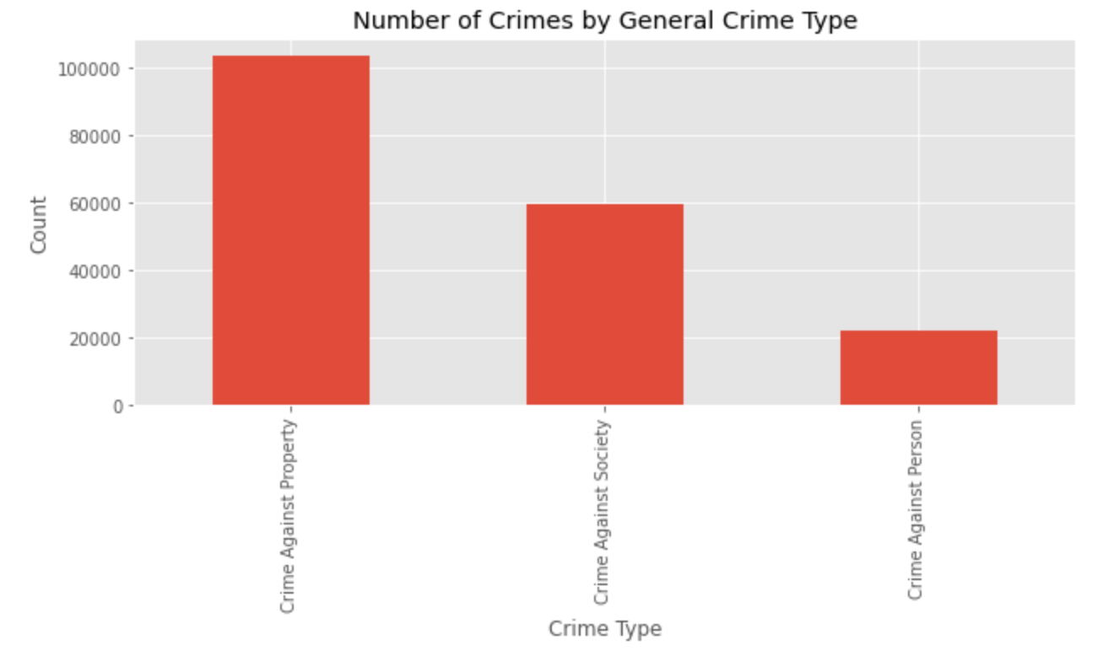
Number of Crimes by general crime type

Slide 4
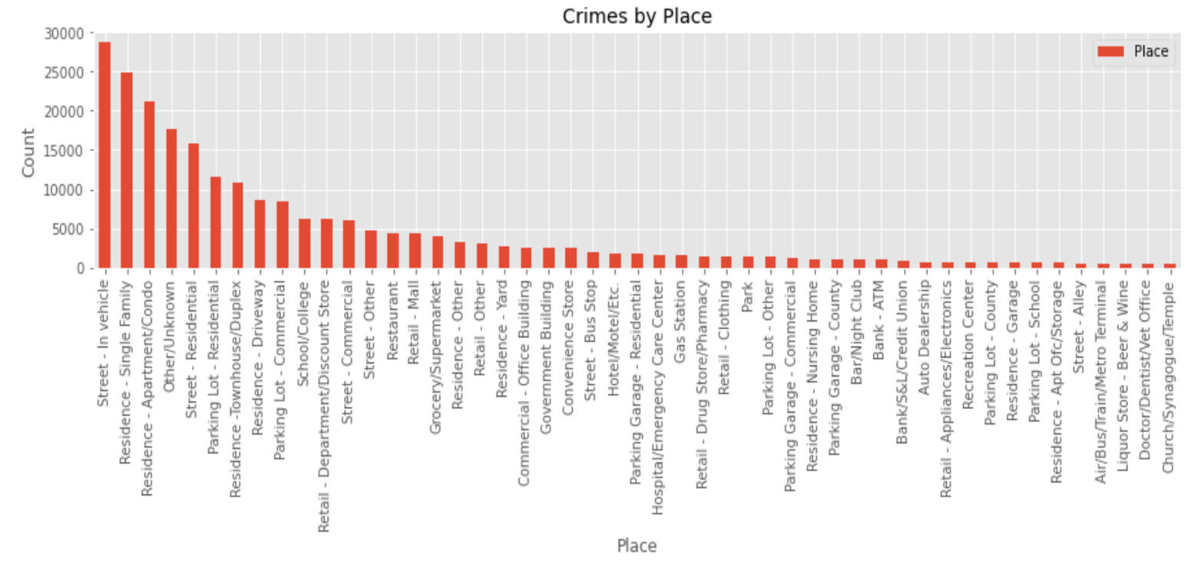
Number of Crimes by Type of place

Slide 5
EDA Summary: Part 1
Almost half of all general crimes were Crimes Against Property
The specific crime types with the largest numbers of crimes were theft from vehicle crimes, marijuana possession crimes, 2nd degree assault crimes, and shoplifting crimes
While crimes that took place in vehicles made up the largest share of crimes that occurred in any specific place, the majority of crimes occurred in residential areas of some type

Slide 6
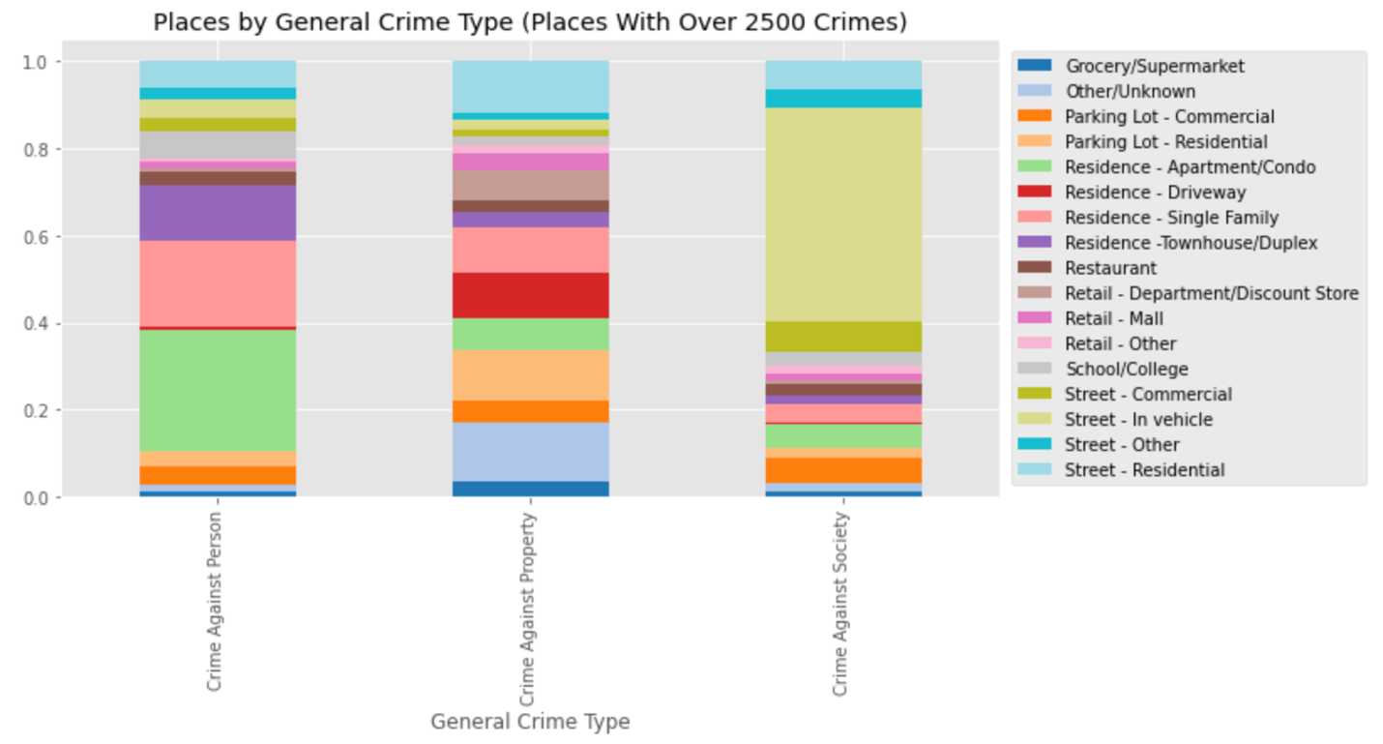
Places by general crime type

Slide 7
EDA Summary: Part 2
Crimes Against Property were basically uniformly distributed among these places, though they occurred primarily in unclassified places and residential parking lots, driveways, and streets
Crimes Against Society predominantly occurred in vehicles and Crimes Against Persons primarily occurred in apartments, single-family residences, and townhouses.
That said, crimes that took place in apartments and single family homes also accounted for a large proportion of Crimes Against Property
Given that Crimes Against Property made up over half of all crimes, the number of Crimes Against Property that took place in apartments and single family residences was probably very similar

Slide 8
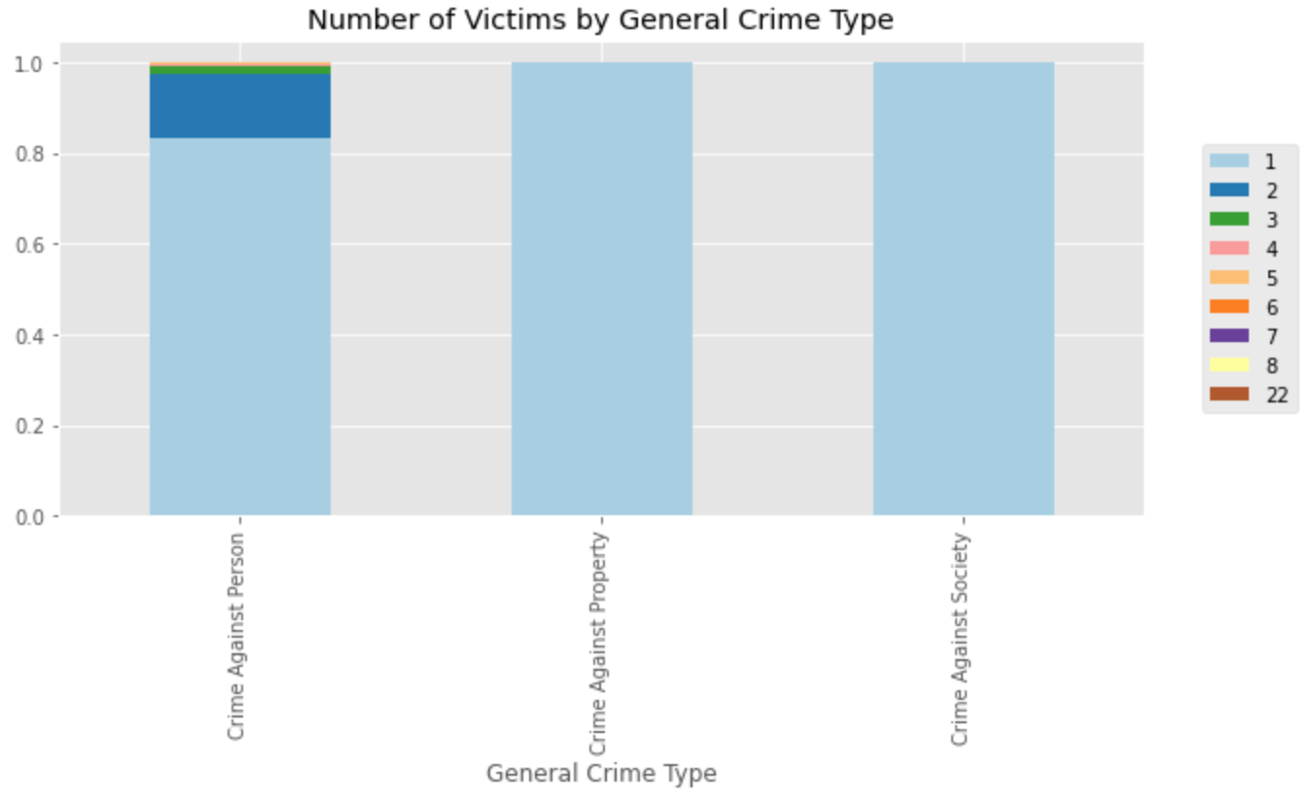
Number of victims by General crime type

Slide 9
EDA Summary: Part 3
Crimes with more than one victim account for almost 20% of all Crimes Against Persons
Of those crimes, the majority involved 2 victims

Slide 10
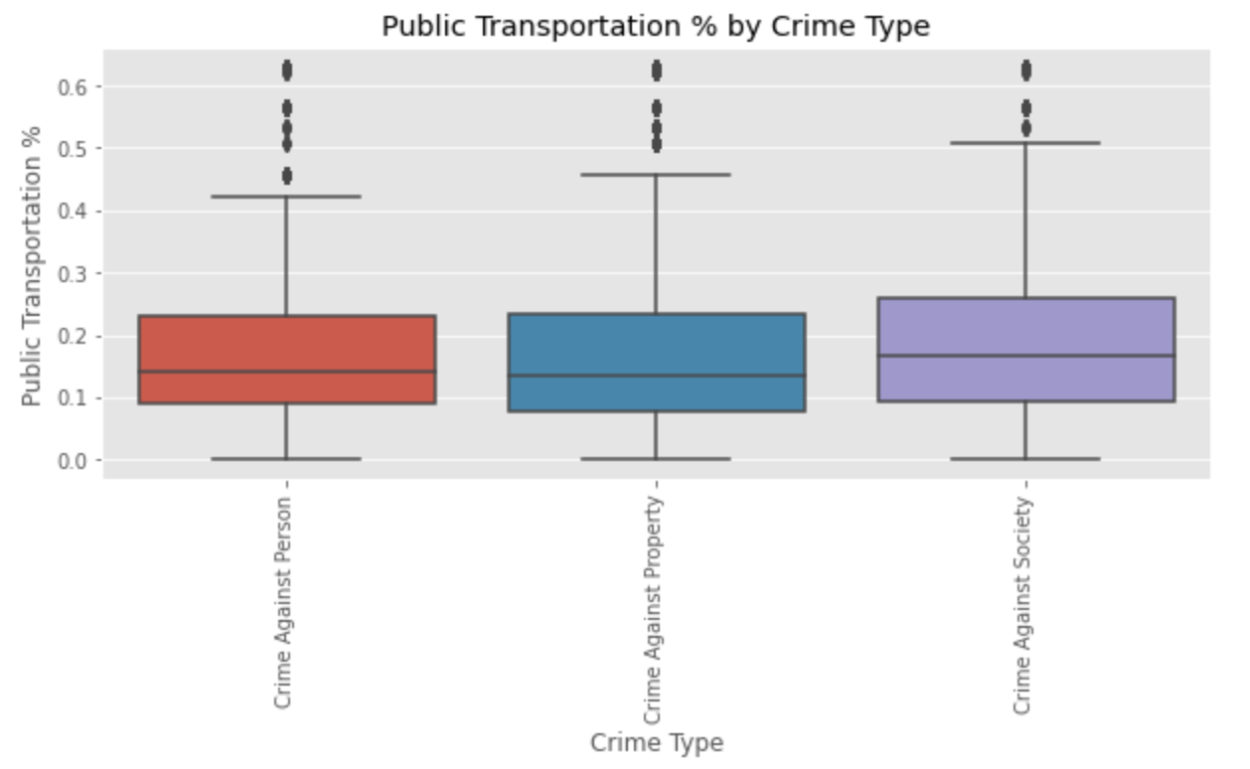
Public Transportation by Crime Type

Slide 11
EDA Summary: Part 4
The distribution of Crimes Against Society is noticeably shifted upward, indicating that Crimes Against Society tended to occur in places with a slightly higher public transportation percentage.

Slide 12
Modeling: Phase 1
Is it be possible to predict whether a given crime is a Crime Against Society, Persons, or Property based on socioeconomic census block data, place data, and victims count data?

Slide 13
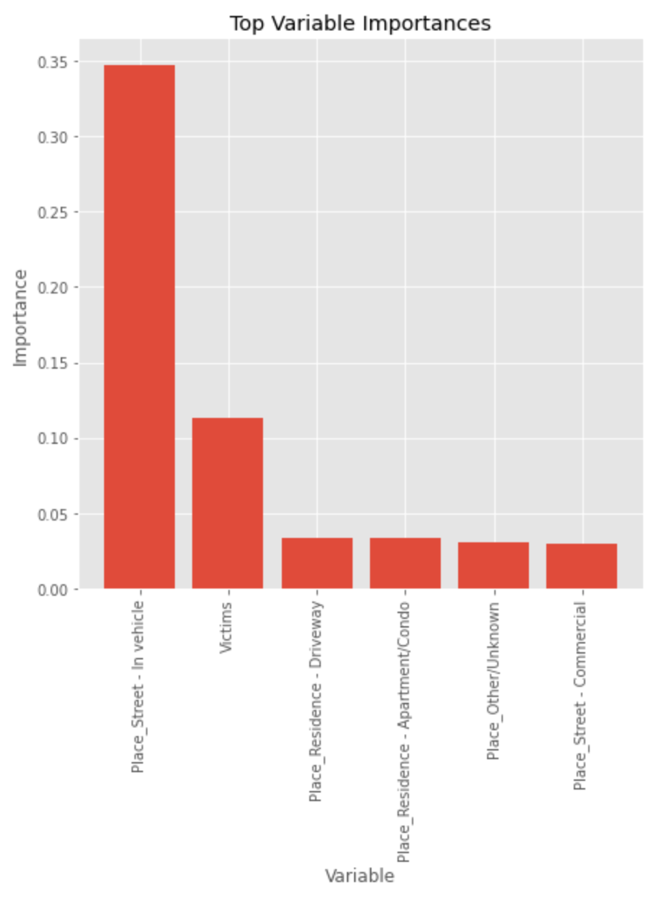
variable importance for Best Model (Class Imbalance)

Slide 14
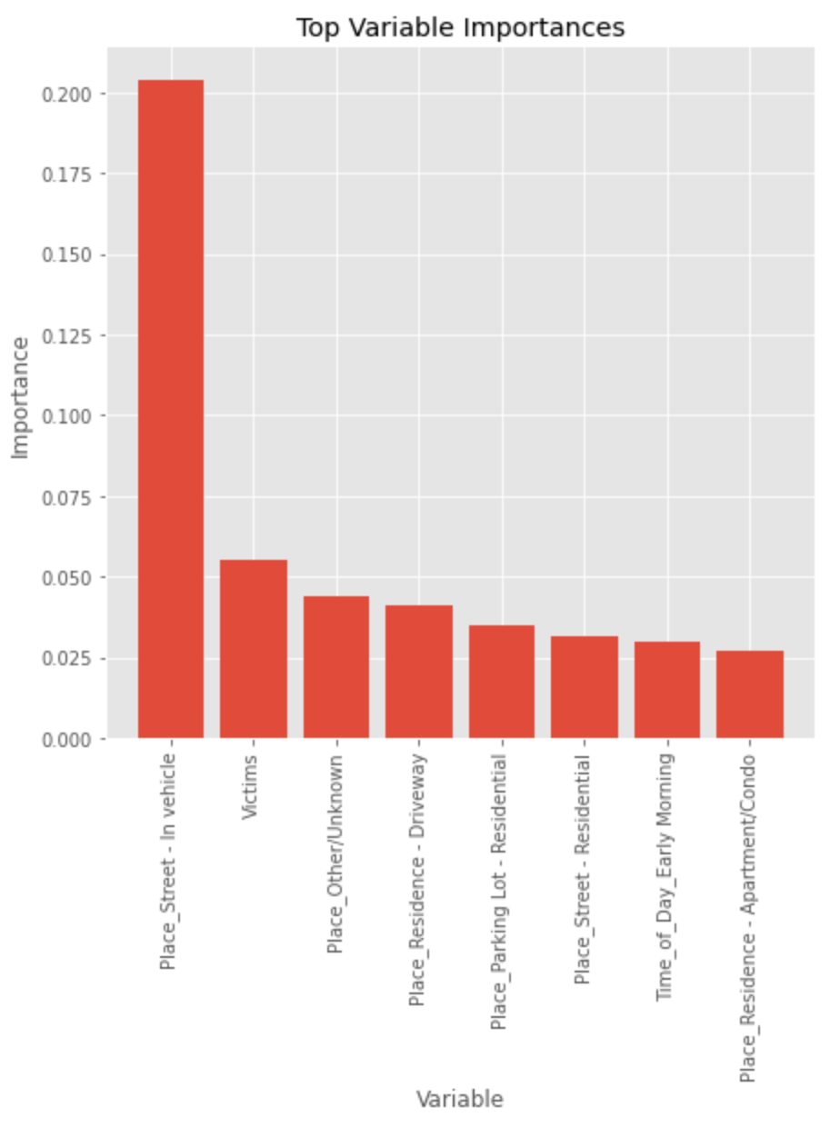
variable importance for Best Model (Class Balance)

Slide 15
Modeling summary: Part 1
Most crimes took place in vehicles and the crimes that took place in vehicles were predominantly Crimes Against Society, so it was not surprising that this was the most important variable across both models
The victims variable was very important to both models, which was expected since Crimes Against Property and Crimes Against Persons were otherwise difficult to differentiate
The class balanced model found more of the places where Crimes Against Property predominantly occurred to be important, presumably to distinguish them from Crimes Against Persons

Slide 16
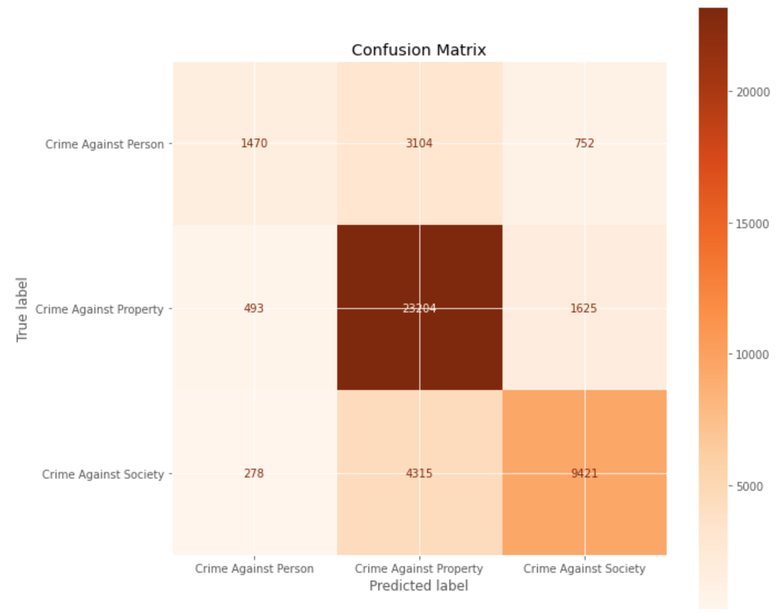
confusion matrix for Best model (Class Imbalance)

Slide 17
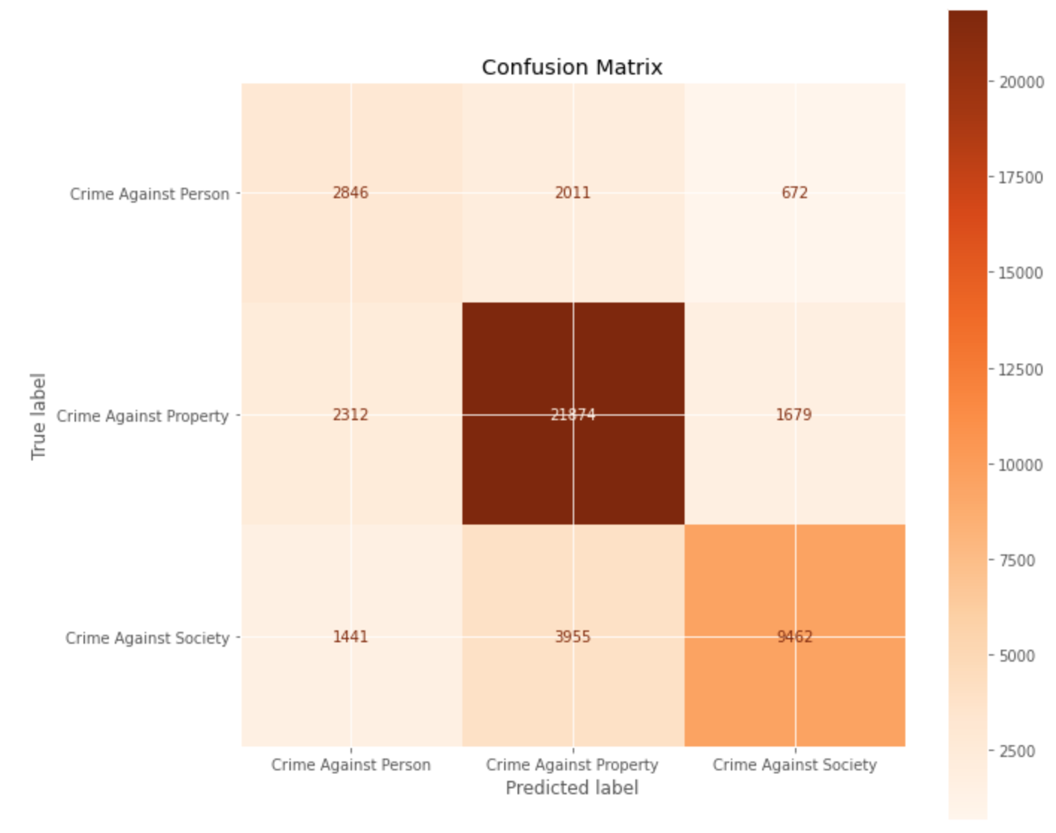
confusion matrix for Best model (Class Balance)

Slide 18
Modeling Summary: Part 2
Both models do a poor job of differentiating Crimes Against Persons from Crimes Against Property, as was anticipated during EDA
For the class imbalanced model, Crimes Against Persons were predicted incorrectly as Crimes Against Property more often than they were predicted correctly.
The class balanced model improved the recall score of the Crimes Against Persons class but slightly worsened its precision score and the recall score of the Crimes Against Property Class

Slide 19
Summary of Accuracy results
 | Class Imbalance | Class Balance
Baseline/Dummy | 0.567 | 0.567
Arbitrary Random Forest | 0.735 | 0.698
Arbitrary Neural Network | 0.743 | 0.717
Best Random Forest | 0.734 | 0.654
Best XGB | 0.748 | 0.727
Best LGB | 0.753 | 0.739

Slide 20
Summary of Avg Precision (PR AUC) results
Type of Model | Class Imbalance | Class Balance
Arbitrary Random Forest | 0.795 | 0.760
Arbitrary Neural Network | 0.823 | 0.822
Best Random Forest | 0.811 | 0.752
Best XGB | 0.829 | 0.811
Best LGB | 0.837 | 0.823

Slide 21
Summary of roc AUC results
Type of Model | Class Imbalance | Class Balance
Arbitrary Random Forest | 0.838 | 0.826
Arbitrary Neural Network | 0.847 | 0.855
Best Random Forest | 0.843 | 0.832
Best XGB | 0.862 | 0.856
Best LGB | 0.866 | 0.862

Slide 22
Summary of log loss
Type of Model | Class Imbalance | Class Balance
Arbitrary Random Forest | 1.459 | 1.629
Arbitrary Neural Network | 0.636 | 0.677
Best Random Forest | 0.659 | 0.764
Best XGB | 0.651 | 0.673
Best LGB | 0.613 | 0.646

Slide 23
Modeling summary: part 3
The best model for both class balanced and class imbalanced data was the light gradient boosted (lgb) tree model
The lgb model performed better on the class imbalanced data, but not by much.
The class imbalanced model’s accuracy and average precision were 1.4% higher, but its ROC AUC was only 0.4% higher
The gradient-boosted tree models outperformed the arbitrary neural network models, arbitrary random forest models, and the hyperparameter-optimized random forest models
The arbitrary neural networks outperformed the best random forest models

Slide 24
Modeling: phase 2
Is it possible to predict the number of crimes that will occur tomorrow by crime type?

Slide 25
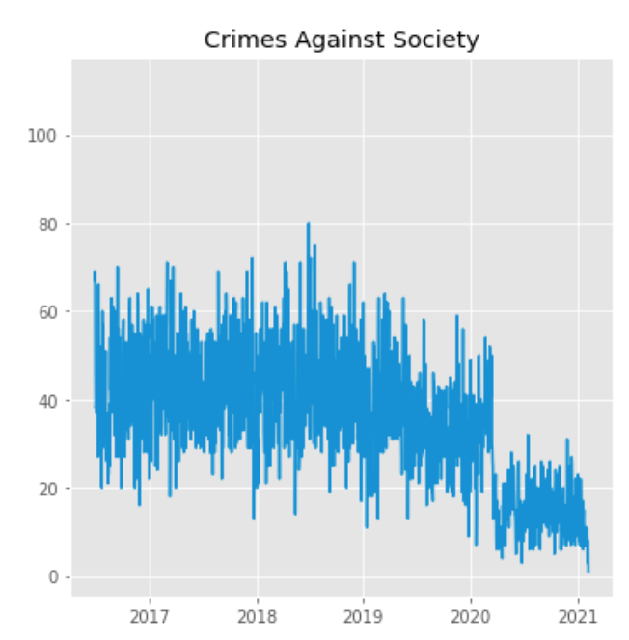
Crimes Against Society Over Time

Slide 26
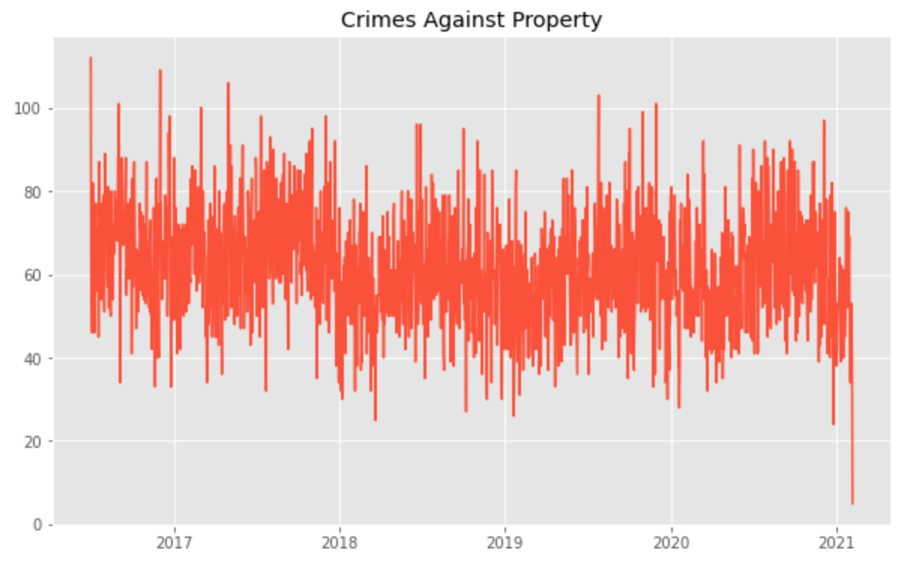
Crimes Against Property over time

Slide 27
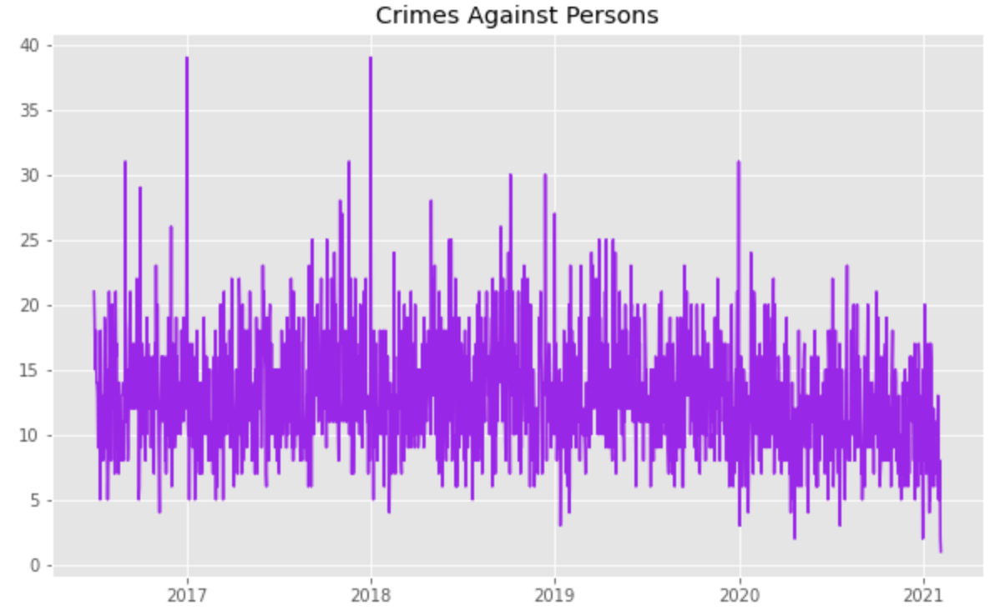
Crimes against persons over time

Slide 28
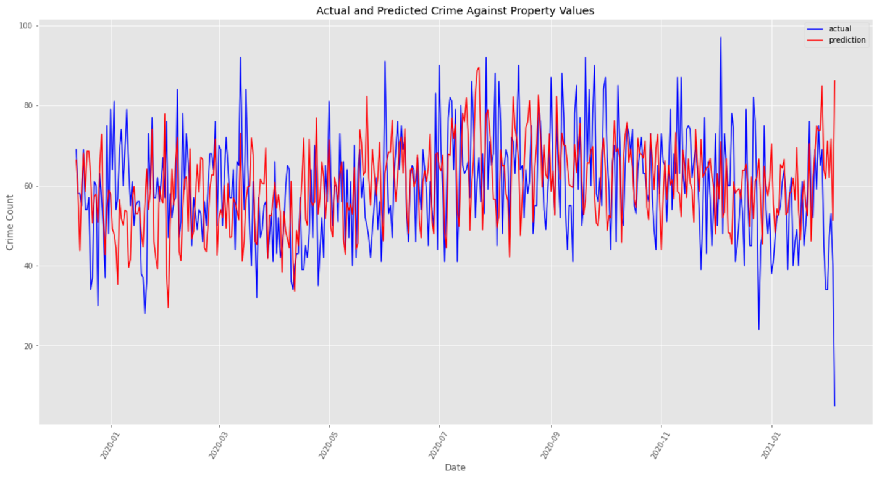
Actual vs Predicted Crimes Against property

Slide 29
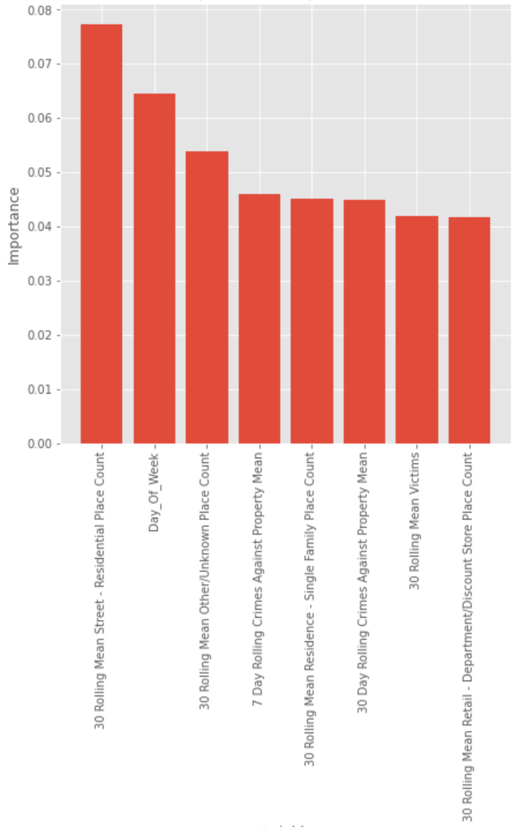
Most Important Variables

Slide 30
Modeling phase 2 summary
Metric | Crimes Against Property
MAE | 11.34
RMSE | 14.52
MAPE | 23.96%

Slide 31
Modeling phase 3
Can we predict the number of crimes that will occur next week by region?

Slide 32
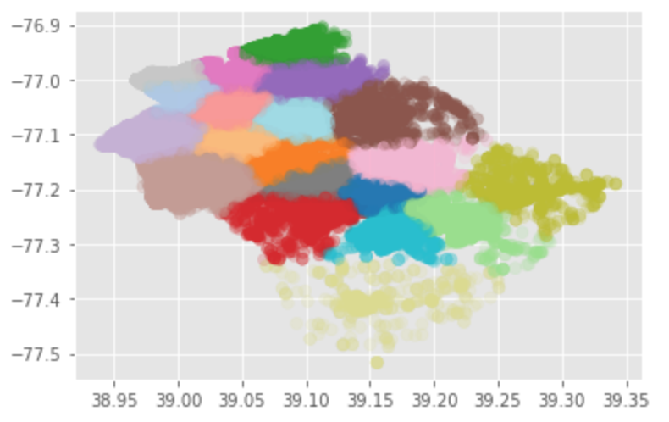
MC Crime Clusters

Slide 33
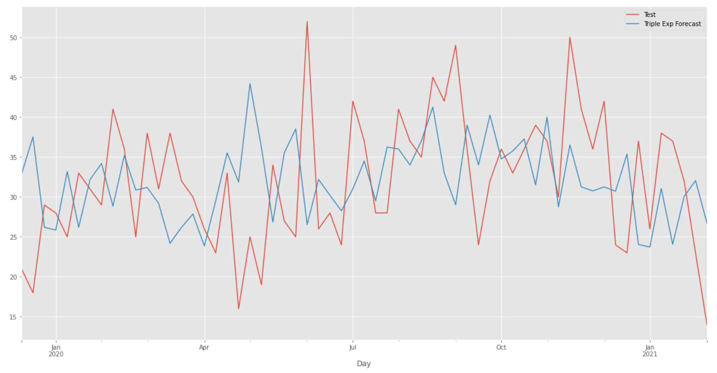
Actual vs predicted crime against property cluster 0

Slide 34
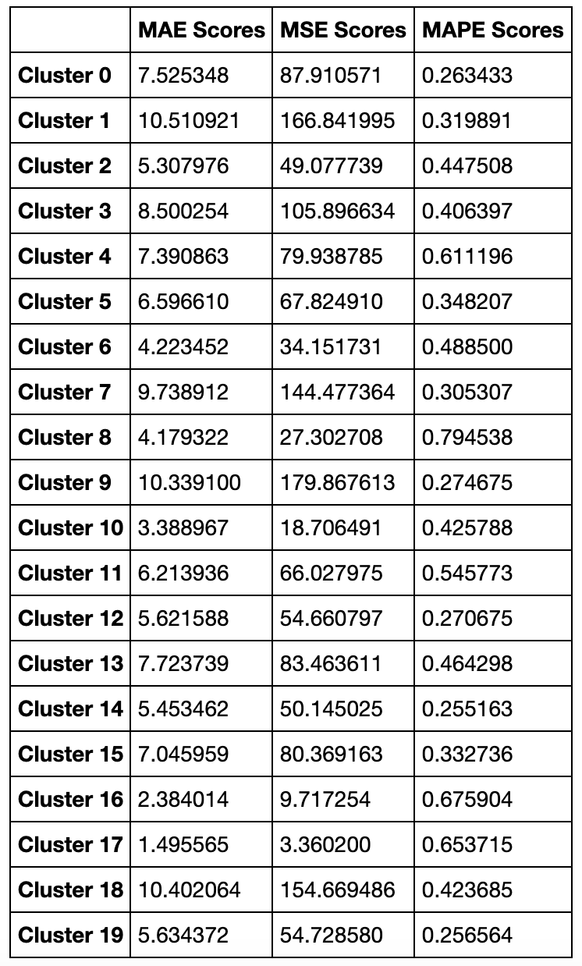
Crimes Against Property Results

